Slide 2

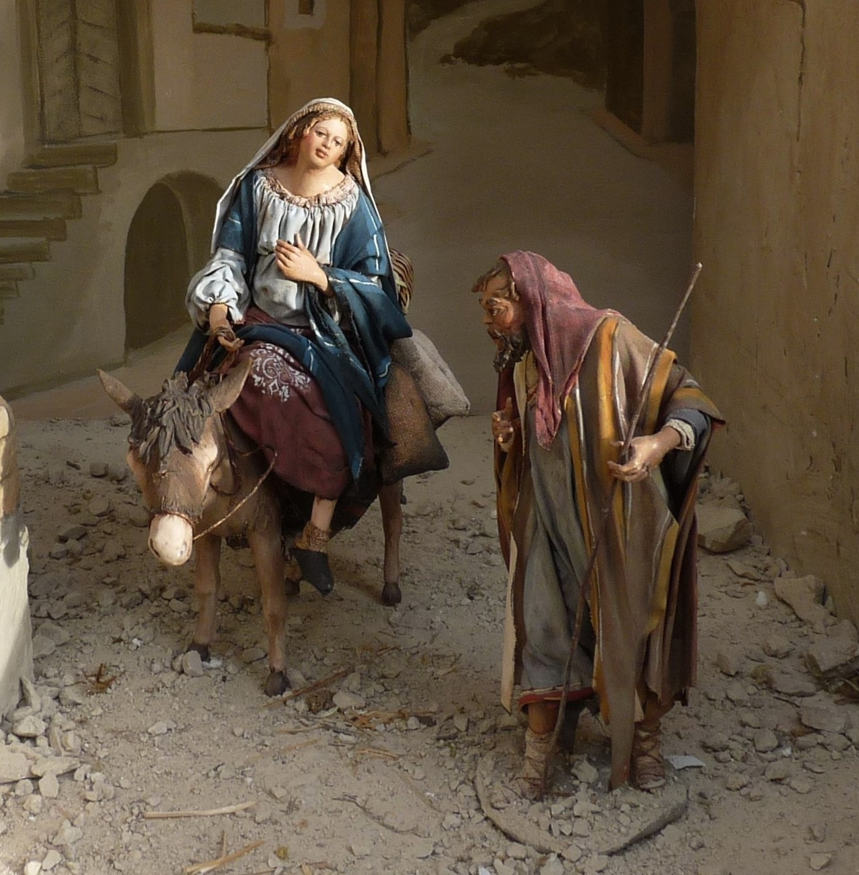
The Virgin Birth
biblestudylessons.com

Slide 3
Liberalism and the virgin birth
“… one of the challenging things about [Jesus’ birth] is the ‘unbelievable’ nature of stories in the Bible describing Jesus’ miraculous conception.
“A lot of people don’t believe it, and I understand that… Maybe the thought is they had to come up with some kind of myth about the birth of Jesus to give him street cred later on. …
“Matthew gives us a version of the birth of Christ, Luke does, but Mark and John, they don’t even mention it. A lot has been made about that.
“Christianity doesn’t hinge on the truth or even the stories around the birth of Jesus. It really hinges on the resurrection of Jesus.” (Baptist News Global, December 21, 2016)

Slide 4
The Virgin Birth
The Bible Teaching

Slide 5
Bible Teaching and the virgin birth
The Bible says Mary conceived without a man.
Matthew 1:18 – with child before she and Joseph came together.
Matthew 1:22,23: Luke 1:27, 31,34 – a virgin; had not known man.
Luke 1:28,30,42,43,48 – She was blessed and highly favored by God
The Virgin Birth fulfilled Old Testament prophecy.
Matthew 1:22,23 – The birth of Jesus fulfilled Isaiah 7:14 that a virgin would conceive and bear a son.
A miracle to prove Jesus was Christ, the Son of God.
Matthew 1:18,20; Luke 1:35 – Shows He is the Son of God.
Matthew 1:21 – He would save people from their sins.
To deny the Virgin Birth is to deny the Holy Spirit did a miracle to prove Jesus was Christ.

Slide 6
The Virgin Birth
The Bible Teaching
The Consequences of Denial

Slide 7
Consequences of Denying virgin birth
Unbelief is progressive.
2 Peter 1:21 – Holy men of God spoke as moved by the Holy Spirit.
Why must a teaching be found in all four accounts?
2 Timothy 3:16,17 – Scriptures are the inspired source of authority in religion. We must obey all that is taught (Acts 3:22,23; Matthew 28:18-20). Jesus’ teaching will judge us (John 12:48).
Galatians 1:8,9 – Do not follow anything different
The modernist approach leaves us with no authority except human wisdom and opinion. Either we accept the Bible as completely God’s word with no errors, or else we completely reject it as having no authority at all.

Slide 9
© Copyright David E. Pratte, 2023
Permission is granted to display this PowerPoint under the following conditions:
* Display the link to BibleStudyLessons.com
* Minor changes in content are permitted, but no teaching should be presented that disagrees with the teaching in the article associated with this PowerPoint at www.BibleStudyLessons.com/powerpoint
* In no case may a fee of any kind be charged for our PowerPoints.
* If you have a website, please add a link to https://BibleStudyLessons.com
Scripture quotations are generally from the New King James Version (NKJV), copyright 1982, 1988 by Thomas Nelson, Inc. Used by permission. All rights reserved.
biblestudylessons.com

