Slide 1
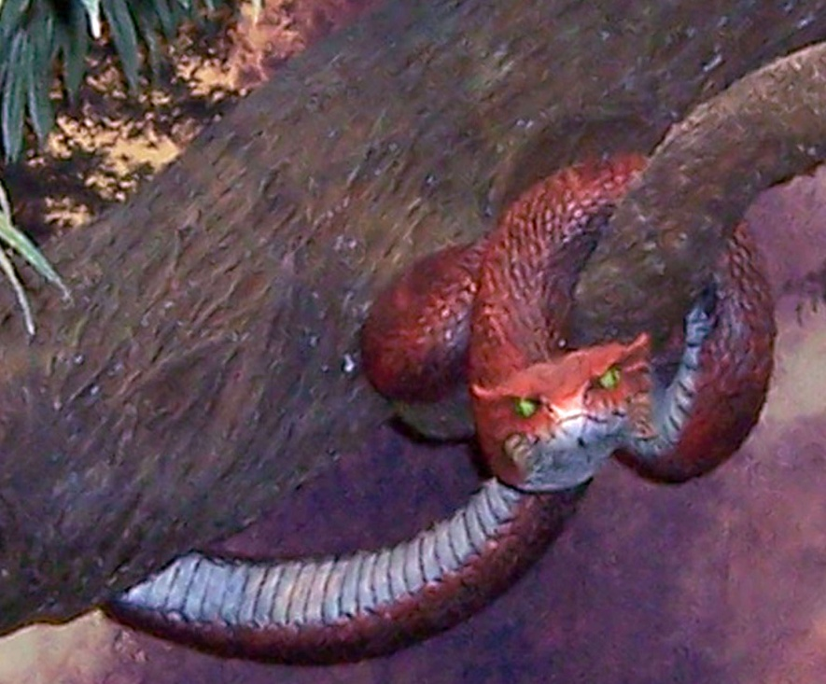
What Sin Has Done for Mankind
In This Life
www.BibleStudyLessons.com

Slide 2
Consequences of Sin in This Life
Sickness, Pain, and Death
Genesis 3:16,19; 1 Corinthians 15:21,22,25,26; John 11:35; 2 Corinthians 12:7-10; 1 Corinthians 15:21-26
Obstacles and Frustration
Genesis 3:17-19
Alienation Between People
Gen. 4:3-8; 27, 37; Eph. 5:22-25,28; Luke 15:11-32;
2 Sam. 15-18; Eph. 6:1-4; 2 Tim. 4:10; Rom. 12:18
Alienation from God
Genesis 3:8; 2:16,17; Isaiah 59:1,2; Ephesians 2:1-3,12; Colossians 1:21-23
Mental Anguish
Gen. 3:10; Psalm 38:3-8; Matt. 27:3-5; Jonah 1,2; Matt. 6:25-34; Phil. 4:6,7; Matt. 25:46; 26:75; Psalm 32:1-5

Slide 3
What Sin Has Done for Mankind
In This Life
After This Life

Slide 4
Consequences of Sin after This Life
Eternal Punishment
Fire - Matthew 25:41; Revelation 20:10-15
Conscious torment - Revelation 20:10; Luke 16:19-31
Outer darkness - Matthew 8:12
Eternal - Matthew 25:41,46; 2 Thessalonians 1:8,9
Loss of Eternal Life
Heaven - Matthew 5:10-12; 1 Peter 1:3,4;
1 Thessalonians 4:17; 5:9,10
Happiness with no suffering - Romans 2:6-10; Revelation 21:3,4
Eternal life - Matthew 25:46; Romans 6:23; Revelation 21:27

Slide 5
The Gospel of Jesus Is the Answer!
Through Jesus we can be forgiven and endure
Philippians 4:13; John 3:16
What must we do?
Believe, repent, confess, and be baptized — Mark 16:16; Acts 2:38
Live a faithful life — Revelation 2:10; 1 Corinthians 15:58
If we sin again, repent and confess — 1 John 1:8-10; Acts 8:22

Slide 6
© Copyright David E. Pratte, 2019
Permission is granted to display this PowerPoint under the following conditions:
* Display the link to www.BibleStudyLessons.com
* Minor changes in content are permitted, but no teaching should be presented that disagrees with the teaching in the article associated with this PowerPoint on www.BibleStudyLessons.com/powerpoint
* In no case may a fee of any kind be charged for our PowerPoints.
* If you have a website, please add a link to www.BibleStudyLessons.com
Scripture quotations are generally from the New King James Version (NKJV), copyright 1982, 1988 by Thomas Nelson, Inc. Used by permission. All rights reserved.
www.BibleStudyLessons.com

