Slide 2
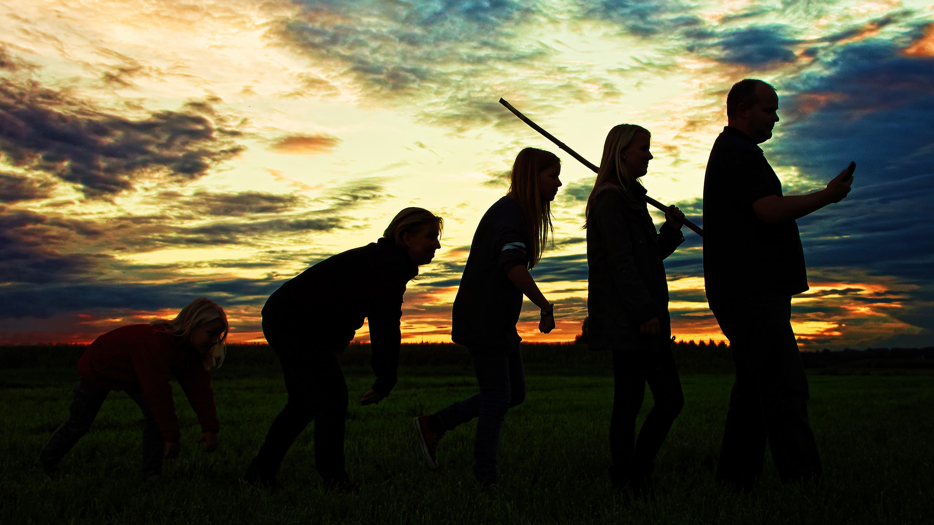
Why People Believe in Evolution
biblestudylessons.com

Slide 3
Why People Believe in Evolution
Suppression of Evidence

Slide 4
Why People Believe in Evolution
Suppression of Evidence
“…scientific men rally to the defense of a doctrine they are unable to define scientifically, much less demonstrate with scientific rigor, attempting to maintain its credit with the public by the suppression of criticism…” (Introduction to a reprint of Darwin’s Origin of Species via Handbook of Religious Quotations, page 64)
Matthew 7:13,14

Slide 5
Why People Believe in Evolution
Suppression of Evidence
Matthew 7:13,14
Consensus of Scientists
1 Corinthians 1:21-23

Slide 6
Why People Believe in Evolution
Suppression of Evidence
Matthew 7:13,14
Consensus of Scientists
1 Corinthians 1:21-23
Ulterior Motives

Slide 7
Why People Believe in Evolution
“I had motives for not wanting the world to have meaning; consequently assumed that it had none, and was able without any difficulty to find satisfying reasons for this assumption ... For myself, as no doubt, for most of my contemporaries, the philosophy of meaninglessness was essentially an instrument of liberation. The liberation we desired was simultaneous liberation from a certain political and economic system, and liberation from a certain system of morality. We objected to the morality because it interfered with our sexual freedom.” – Aldous Huxley (grandson of evolutionist Thomas Huxley) Confessions of a Professed Atheist,” In: Report: Perspectives on the News, June, 1966, page 19. – https://www.azquotes.com/quote/719861

Slide 8
Why People Believe in Evolution
Suppression of Evidence
Matthew 7:13,14
Consensus of Scientists
1 Corinthians 1:21-23
Ulterior Motives
The scientific evidence for creation is stronger than that for evolution. But the issue of creation is primarily a matter, not of science, but of religion or philosophy.
Acts 17:11 - Search God’s word with honest hearts. We know It is true because of evidence from fulfilled prophecy and eyewitness testimony of miracles and the resurrection.

Slide 9
© Copyright David E. Pratte, 2023
Permission is granted to display this PowerPoint under the following conditions:
* Display the link to BibleStudyLessons.com
* Minor changes in content are permitted, but no teaching should be presented that disagrees with the teaching in the article associated with this PowerPoint at www.BibleStudyLessons.com/powerpoint
* In no case may a fee of any kind be charged for our PowerPoints.
* If you have a website, please add a link to https://BibleStudyLessons.com
Scripture quotations are generally from the New King James Version (NKJV), copyright 1982, 1988 by Thomas Nelson, Inc. Used by permission. All rights reserved.
biblestudylessons.com

