Slide 2

Works and Salvation
biblestudylessons.com

Slide 3
Words Used for Different Things
Different kinds of love
Different kinds of faith
Different kinds of obedience
Different kinds of law
Different kinds of works
Some are essential to salvation; some are not.

Slide 4
Works and Salvation
No One Earns Salvation by Sinless Works
biblestudylessons.com

Slide 5
No One Earns Salvation by Sinless Works
This Is the Meaning of “Not by Works” Passages.
Romans 4:4 – To him who works, the wages are not counted as grace but as debt.
Romans 11:6 – And if by grace, then it is no longer of works; otherwise grace is no longer grace. But if it is of works, it is no longer grace; otherwise work is no longer work.
Ephesians 2:8,9 – For by grace you have been saved through faith, and that not of yourselves; it is the gift of God, not of works, lest anyone should boast.
Titus 3:5 – not by works of righteousness which we have done, but according to His mercy He saved us…

Slide 6
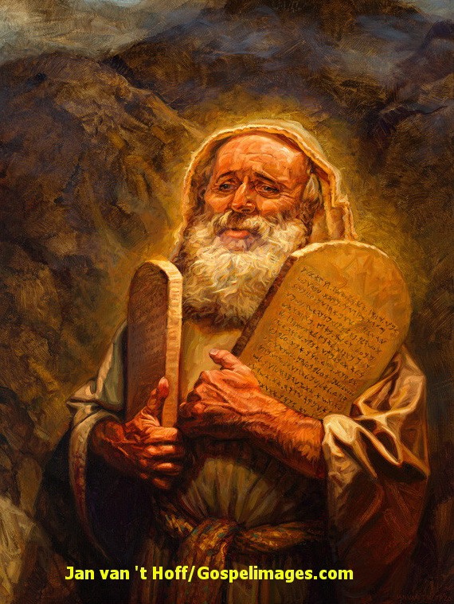
No One Earns Salvation by Sinless Works
The Old Testament Law Illustrates This Kind of Works.
Hebrews 10:1-4 – Animal sacrifices provided no lasting forgiveness.
Galatians 3:10 – Any sin put one under a curse; to be justified by such a law one must live one’s whole life without sin.
But we all sin (Romans 3:23; 1 John 1:8,10; 3:4). So, we all need grace to forgive us.

Slide 7
No One Earns Salvation by Sinless Works
Other Verses Near “Not by Works” Verses Say We Must Obey.
Not by Works | But We Must Obey
Galatians 2:16; 3:11 - not saved by works | 3:27 - baptized into Christ 5:6 - what avails is faith working
Romans 3:20,28; 4:2-16; 11:6 - not by works | 6:3,4 - baptized into Christ/His death 6:17,18 - obey to be free from sin 10:9,10 - confess unto salvation
Titus 3:5 - not by works | through the “washing of regeneration”
Ephesians 2:8,9 - not by works | 5:25,26 - cleansed by the washing of water

Slide 8
Works and Salvation
No One Earns Salvation by Sinless Works
Obedience Is a Necessary Condition to Salvation

Slide 9
Obedience Is a Necessary Condition to Salvation
1 Peter 1:22,23 – We purify our souls in obeying the truth.
Romans 6:17,18 – Obey from the heart to be freed from sin.
Hebrews 5:9 – Jesus is author of salvation to all who obey.
Acts 11:14; 10:34,35 – Peter gave words whereby to be saved: God accepts those who fear Him and work righteousness.
James 2:24 – Man is justified by works, not by “faith only.”
Matthew 7:21-27 – To accept Jesus as Lord (ruler, master) and enter the kingdom of heaven, we must do what He says.
2 Thessalonians 1:8,9 – Those who do not obey: be destroyed.
Romans 2:6-10; 2 Corinthians 5:10 – We will be judged according to works (what is done in the body.)

Slide 10
Obedience Is a Necessary Condition to Salvation
If No Obedience Is Needed, None of These Are Needed:
Repentance - Acts 17:30
Confession - Romans 10:9,10
Love - Matthew 22:37-39
Faith itself - 1 John 3:23; John 6:28,29
Baptism - Mark 16:16; Acts 2:38; 22:16;
Romans 6:3,4; 1 Peter 3:21
None of these works earn salvation, but all of them are essential conditions to receive forgiveness by the grace of God through the sacrifice of Jesus.

Slide 11
Works and Salvation
No One Earns Salvation by Sinless Works
Obedience Is a Necessary Condition to Salvation
Obedience and Good Attitudes Are Both Essential

Slide 12
Obedience and Proper Attitudes Are Both Necessary.
Obedience Must Be Sincere from the Heart
Romans 6:17,18 – To be set free from sin we must obey from the heart.
Galatians 5:6 – What avails in Christ is faith working through love.
1 John 5:3 – For this is the love of God, that we keep His commandments. (2 John 6; John 14:15).
It is not a matter of choosing between faith and works. Both are required.

Slide 13
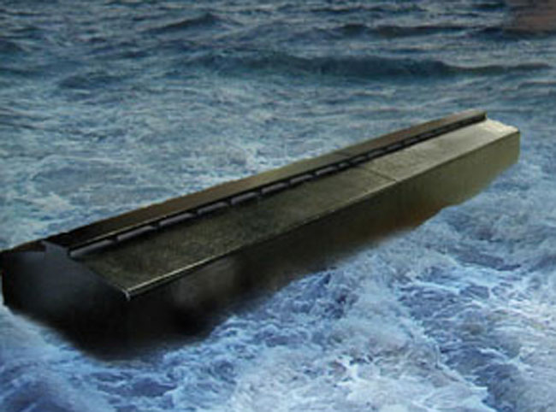
Illustrations of Faith to the Saving of the Soul
            Hebrews 10:39; chapter 11
            Noah built the ark then his house was saved (11:7)

Slide 14
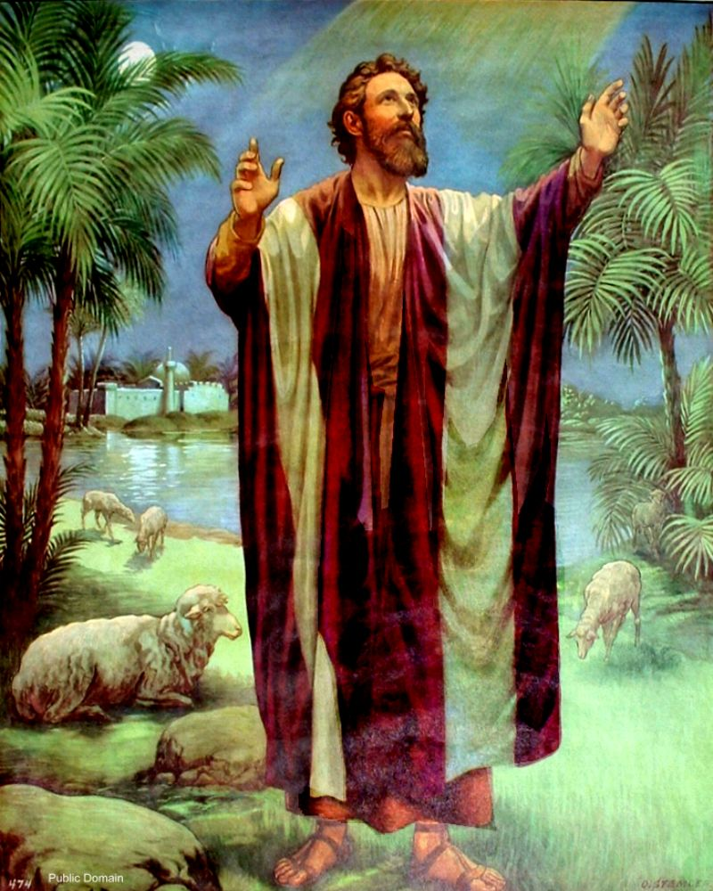
Illustrations of Faith to the Saving of the Soul
            Hebrews 10:39; chapter 11
            Noah built the ark then his house was saved (11:7)
            Abraham obeyed to go then received the inheritance (11:18)

Slide 15
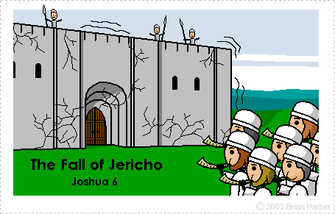
Illustrations of Faith to the Saving of the Soul
            Hebrews 10:39; chapter 11
            Noah built the ark then his house was saved (11:7)
            Abraham obeyed to go then received the inheritance (11:18)
            Israel marched then the walls of Jericho fell (11:30)

Slide 16
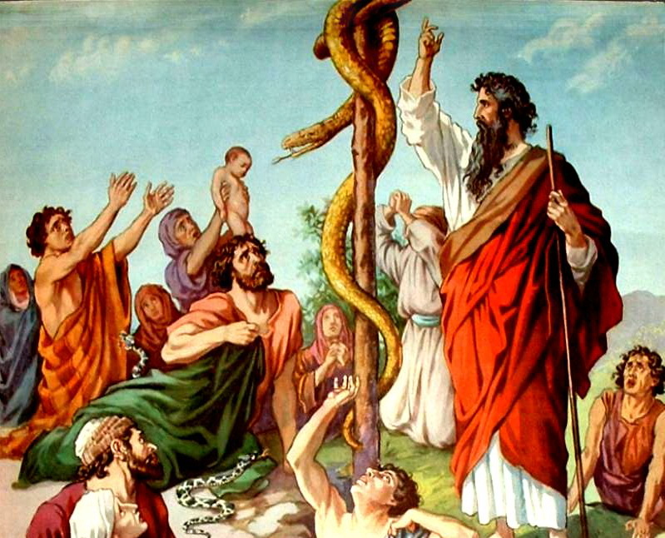
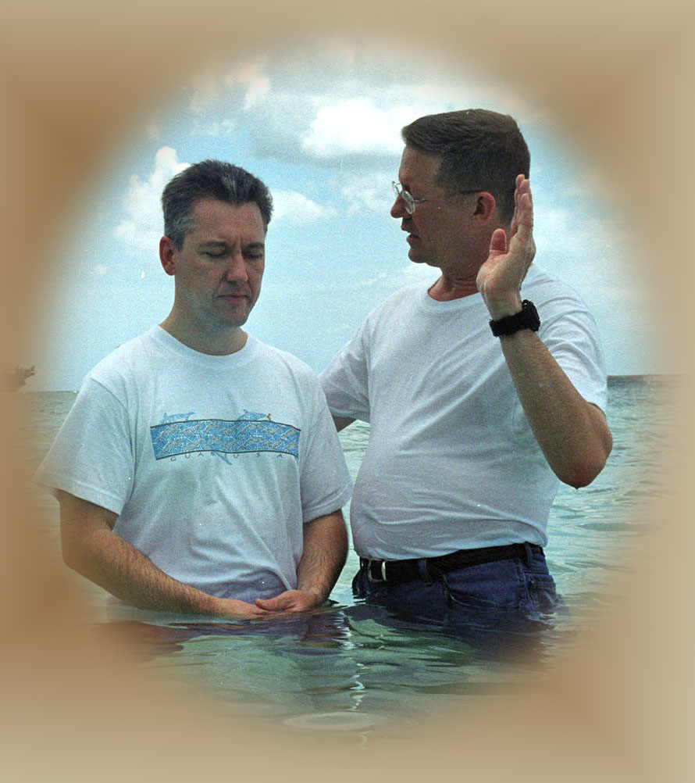
Illustrations of Faith to the Saving of the Soul
            Hebrews 10:39; chapter 11
            Noah built the ark then his house was saved (11:7)
            Abraham obeyed to go then received the inheritance (11:18)
            Israel marched then the walls of Jericho fell (11:30)
John 3:14-16 - Bronze serpent illustrates salvation by faith. To be saved from death, the people had to act (Numbers 21:9).

Slide 17
Illustrations of Faith to the Saving of the Soul
            Hebrews 10:39; chapter 11
            Noah built the ark then his house was saved (11:7)
            Abraham obeyed to go then received the inheritance (11:8)
            Israel marched then the walls of Jericho fell (11:30)
John 3:14-16 - Bronze serpent illustrates salvation by faith. To be saved from death, the people had to act (Numbers 21:9).
James 2:14-26 - Faith that does not work is dead. We are justified by works, not by “faith only.”
We obey the gospel then receive forgiveness (Mark 16:16)

Slide 18
Works and Salvation
No One Earns Salvation by Sinless Works
Obedience Is a Necessary Condition to Salvation
Obedience and Good Attitudes Are Both Essential
Continued Obedience Is Essential for Children of God

Slide 19

Continued Obedience Is Essential for Children of God
Luke 6:46 – Why do you call Me “Lord, Lord,” and do not do the things which I say?
Colossians 1:10 – Walk worthy of the Lord, fully pleasing Him, fruitful in every good work.
Titus 2:14 – Jesus gave Himself … to purify for Himself His own special people, zealous for good works.
James 1:25 – He who continues in the perfect law of liberty and is … a doer of the work … will be blessed in what he does.

Slide 20
Are Good Deeds Necessary to Receive Eternal Life?
Philippians 2:12 – Work out your own salvation with fear….
Revelation 20:13 – We will be judged each one according to his works. (2 Corinthians 5:10; Revelation 2:23; 22:12)
Romans 2:6-10 – God will render to each according to his deeds: eternal life to those who patiently continue doing good
Galatians 6:8,9 - Not grow weary while doing good, for in due season we shall reap everlasting life if we do not lose heart
Romans 8:13 – Put to death the deeds of the body, you will live
Revelation 2:10 – Be faithful until death, and I will give you the crown of life.

Slide 21
Works and Salvation
No One Earns Salvation by Sinless Works
Obedience Is a Necessary Condition to Salvation
Obedience and Good Attitudes Are Both Essential
Continued Obedience Is Essential for Children of God

Slide 22
Works and Salvation
No one will earn salvation by a sinless life or mere outward ritual. Salvation is a gift by God’s grace through the sacrifice of Jesus. We receive forgiveness at conversion on the condition of faith expressed in obedience including baptism. We must then live a life of faithful service. If we sin again, we must meet conditions of repentance and prayer
(Acts 8:22; 1 John 1:8-10).

Slide 24
© Copyright David E. Pratte, 2023
Permission is granted to display this PowerPoint under the following conditions:
* Display the link to BibleStudyLessons.com
* Minor changes in content are permitted, but no teaching should be presented that disagrees with the teaching in the article associated with this PowerPoint at www.BibleStudyLessons.com/powerpoint
* In no case may a fee of any kind be charged for our PowerPoints.
* If you have a website, please add a link to https://BibleStudyLessons.com
Scripture quotations are generally from the New King James Version (NKJV), copyright 1982, 1988 by Thomas Nelson, Inc. Used by permission. All rights reserved.
biblestudylessons.com

