Slide 2
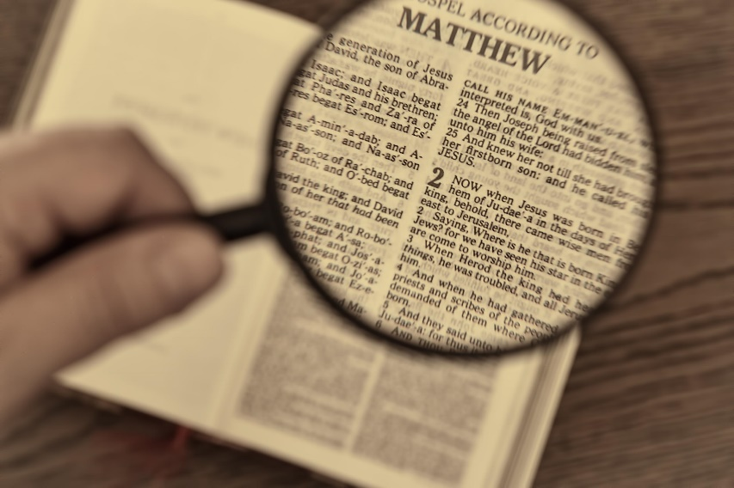
Video Bible Study
presented by
David E. Pratte
www.gospelway.com

Slide 3
The Prophecy of Zephaniah
Thanks to Christians in the Hillcrest church for their participation.
© Copyright David E. Pratte, 2022
Scripture quotations are generally from the New King James Version (NKJV), copyright 1982, 1988 by Thomas Nelson, Inc. used by permission. All rights reserved.

Slide 4
Questions from Bible Study Questions on Jonah, Micah, Nahum, Habakkuk, Zephaniah
Available at
www.biblestudylessons.com/classbooks

Slide 5
Understanding Old Testament Prophecy
* The prophets are part of Scripture, and all Scripture is profitable to equip us in our service to God today
– 2 Timothy 3:16,17; Romans 15:4; 1 Corinthians 10:6,11.
* Old Testament history may help us understand the background behind prophets’ teachings.
* The prophets often used symbolic teaching. But that does not give us the right to assign a meaning to the symbols according to our own imagination.
* The prophets often included predictions about the Messiah, His Kingdom, and His message.
* Often New Testament writers give us an inspired explanation.

Slide 6
Periods of Bible history
1. Before the Flood (Creation to the flood)
2. After the Flood (the flood to the call of Abraham)
3. Patriarchs (the call of Abraham to the death of Joseph)
4. Egyptian Bondage (Joseph’s death to crossing Red Sea)
5. Wilderness Wandering (Red Sea to crossing the Jordan)
6. Conquest of Canaan (crossing Jordan to Joshua’s death)
7. Judges (death of Joshua to crowning of King Saul)
8. United Kingdom (crowning of Saul to death of Solomon)
9. Divided Kingdom (death of Solomon to the fall of Israel)
10. Judah Alone (the fall of Israel to the fall of Judah)
11. Babylonian Captivity (fall of Judah to end of captivity)
12. Restoration of Israel (return to the completion of OT)
13. Years of Silence (completion of OT to the birth of Jesus)
14. Life of Christ (from the birth of Jesus to His ascension)
15. Early Church (Jesus’ ascension to the completion of NT)

Slide 7
Prophets by Period
Period of History | Prophets
Divided Kingdom | Israel: Jonah Amos Hosea | Judah: Obadiah (?) Joel (?) Isaiah Micah
Judah Alone | Jeremiah (Lamentations) Zephaniah Nahum (?) Habakkuk (?)
Babylonian Captivity | Ezekiel Daniel
Return from Captivity | Haggai Zechariah Malachi

Slide 8
Prophets and Kings of Judah Alone
Prophets
Jeremiah ------>(Lamentations)
Zephaniah
Nahum (?)
Habakkuk (?)
Manasseh
Amnon
Jehoaichin
Josiah (r)
Jehoiakim
Zedekiah
Hezekiah (r)
Jehoahaz
Kings

Slide 9
Themes of the Minor Prophets
Hosea – Israel’s unfaithfulness compared to Hosea’s wife
Joel – Locust plague shows Israel’s need to repent
Amos – Israel would go into captivity because of sins like those of the surrounding nations
Obadiah – Fall of Edom for rejoicing in Judah’s affliction
Jonah – God uses a fish and a plant to teach Jonah His concern for the salvation of Nineveh and all people
Micah – God puts Israel and Judah on trial for their sins.
Nahum – Prophecy of the fall of Nineveh
Habakkuk – Habakkuk questions God’s punishments
Zephaniah – God’s wrath is coming against Jerusalem and surrounding nations, but a remnant will be spared.
Haggai – Returning Jews should rebuild the temple
Zechariah – The future glory of God’s people
Malachi – Spiritual restoration among the returned Jews

Slide 10
Theme and Major Divisions of Zephaniah
Theme: God’s wrath is coming against Jerusalem and surrounding nations, but a remnant will be spared.
Major divisions
Chapter 1 – Punishment and destruction to come upon the nation
Chapter 2 – Prophecies against surrounding nations
Chapter 3 – Warnings and future hope for the nation

Slide 11
1:1-2:3
Warning of Destruction upon Judah
God would consume everything from Judah and Jerusalem, cutting off every trace of idol worship.
There will be mourning and wailing as God punishes those who thought He would do nothing.
It will be a day of wrath, trouble and distress. No amount of wealth will deliver those who are guilty.
They should repent while they still have opportunity.

Slide 12
Prophecies Against
Surrounding Nations
2:4-15
Against the Philistines

Slide 13
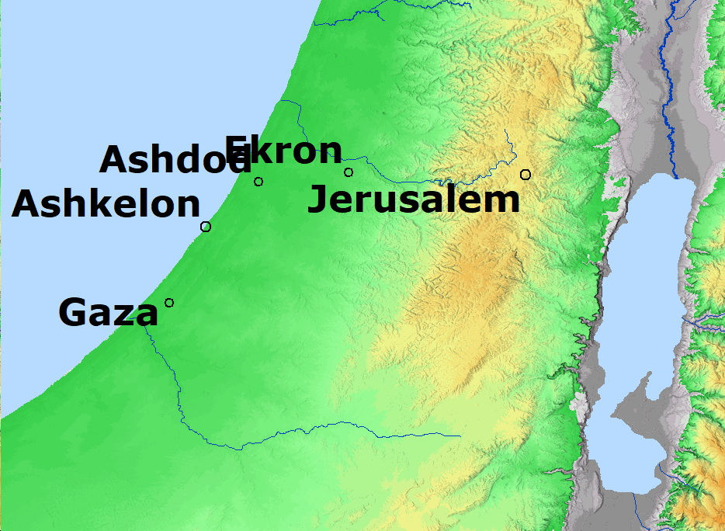
Philistine Cities

Slide 14
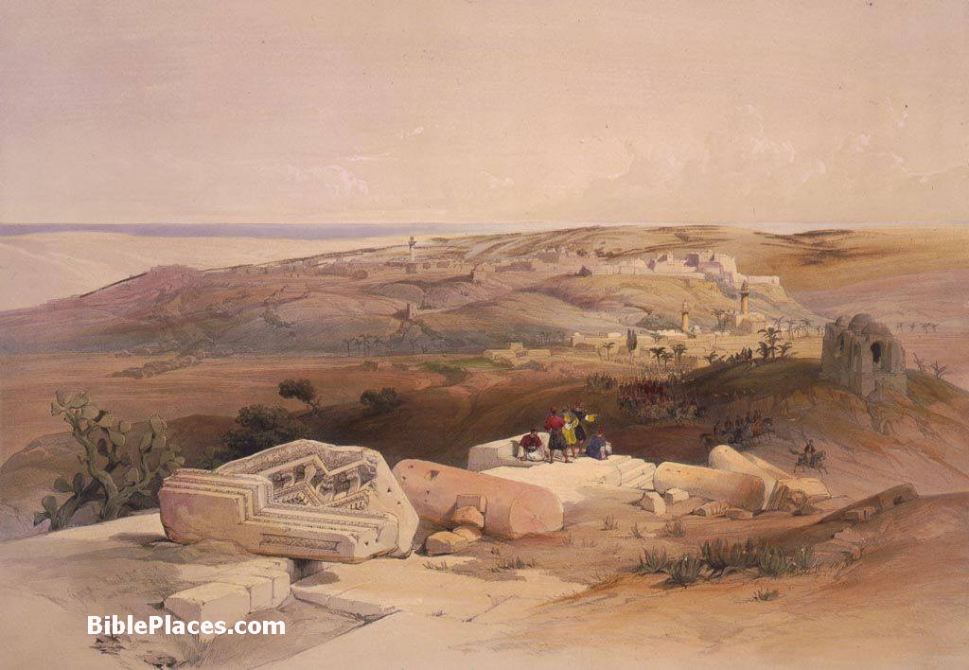
Gaza Would Be Forsaken

Slide 15
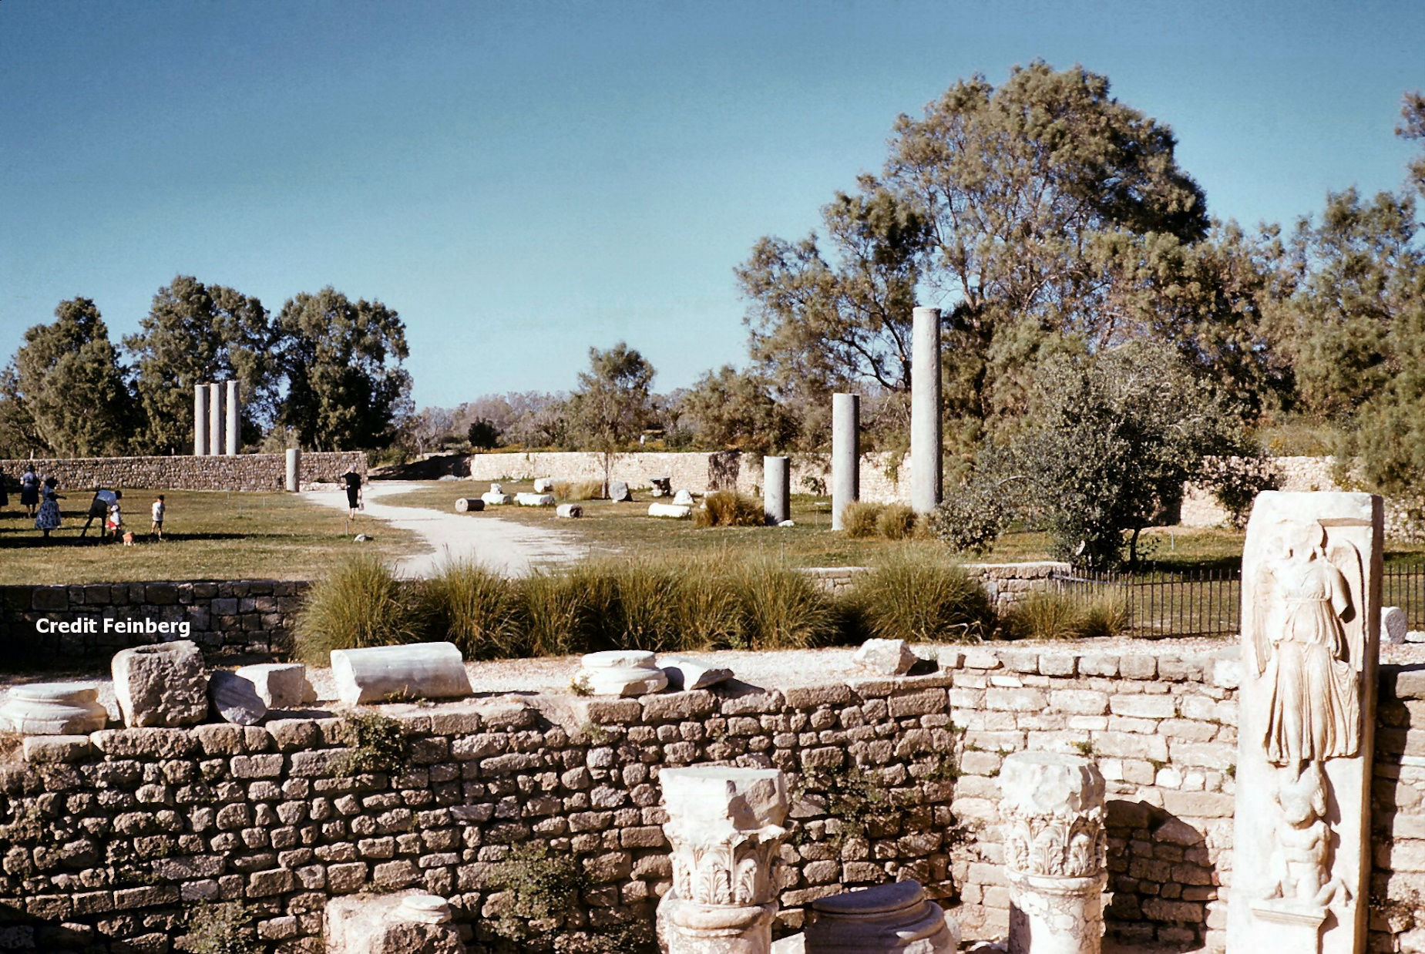
Ashkelon Would Be Desolate

Slide 16
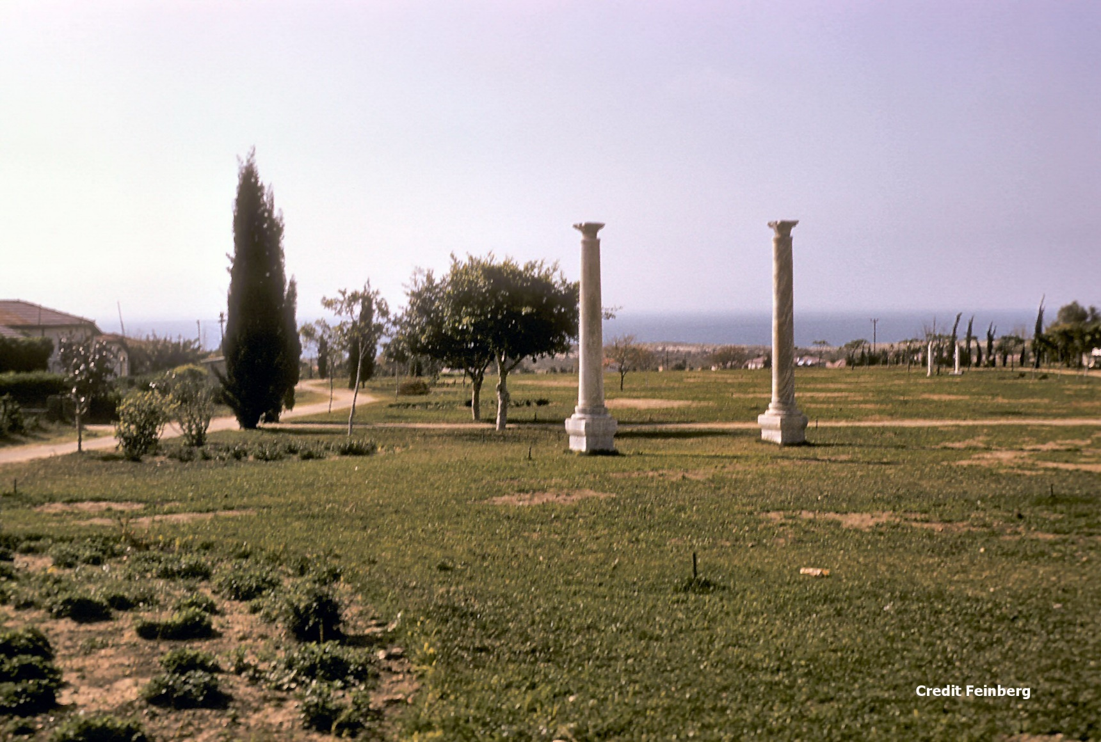
Remains of Ashkelon - 2

Slide 17
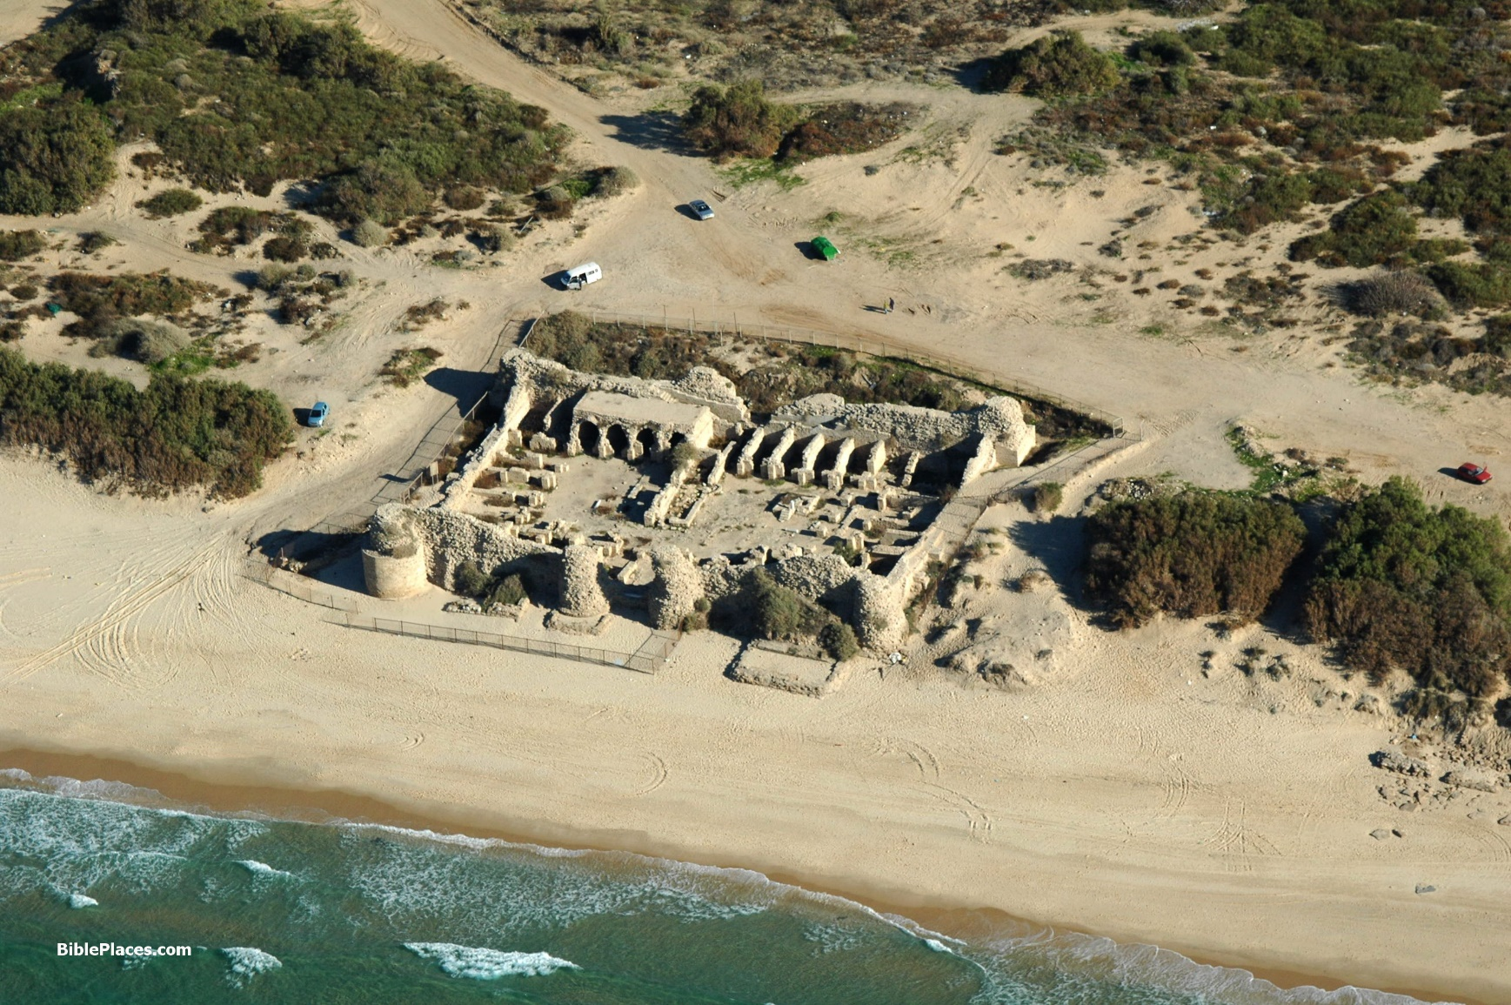
Ashdod Would Be Driven Out

Slide 18
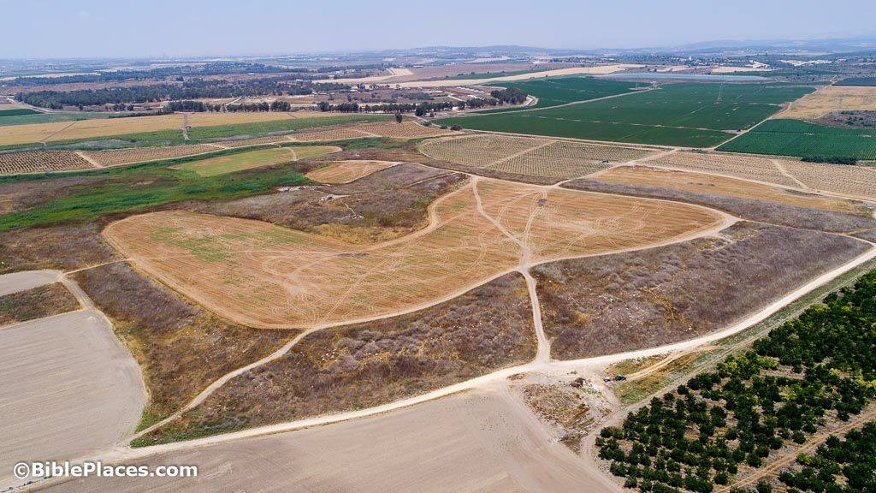
Ekron Would Be Uprooted

Slide 19
Archaeology and Ekron
“… In 625 BC the prophet Zephaniah announced God’s condemnation of Ekron, and in 603 BC the prophecy was fulfilled when the neo-Babylonian king Nebuchadnezzar II invaded Philistia and destroyed Ekron. With this destruction came the end of the Philistine material culture. The Babylonian uprooting of Ekron was so complete that its very location was unknown until the late twentieth century.”
Then in 1997 archaeologists discovered a stela with an inscription from a royal Philistine temple.
“The inscription clearly mentions both the name of the king and the name of his city – Ekron. It is extremely rare to find a monumental inscription with the name of a Biblical site and its ruler in situ and in a datable destruction level.”
– Price, Zondervan Handbook of Archaeology, pages 187,188

Slide 20
Prophecies Against
Surrounding Nations
2:4-15
Against the Philistines
Against Moab and Ammon

Slide 21
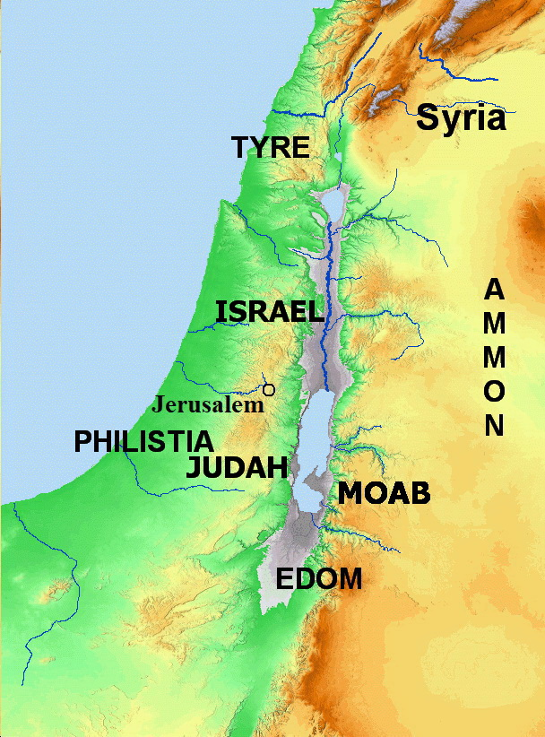
Prophecies Against
Surrounding Nations

Slide 22
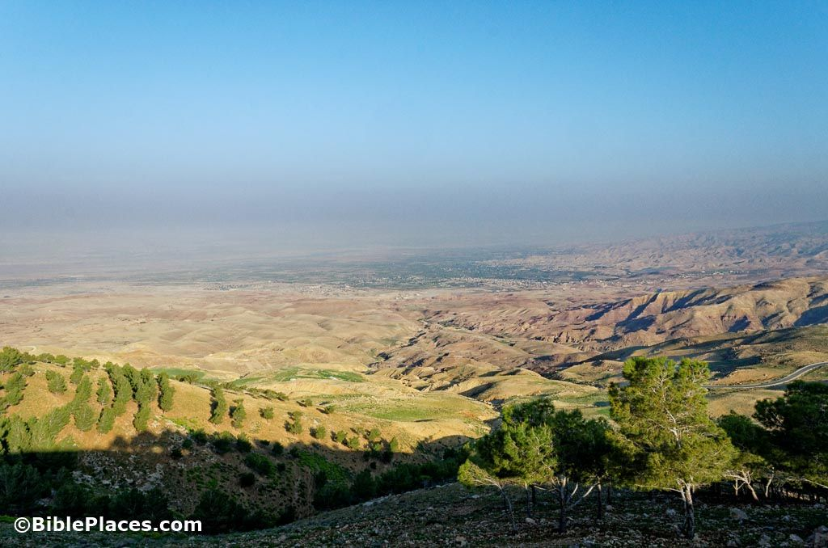
Moab Would Be Desolate

Slide 23
Prophecies Against
Surrounding Nations
2:4-15
Against the Philistines
Against Moab and Ammon
Against the Ethiopians
Against Assyria

Slide 24
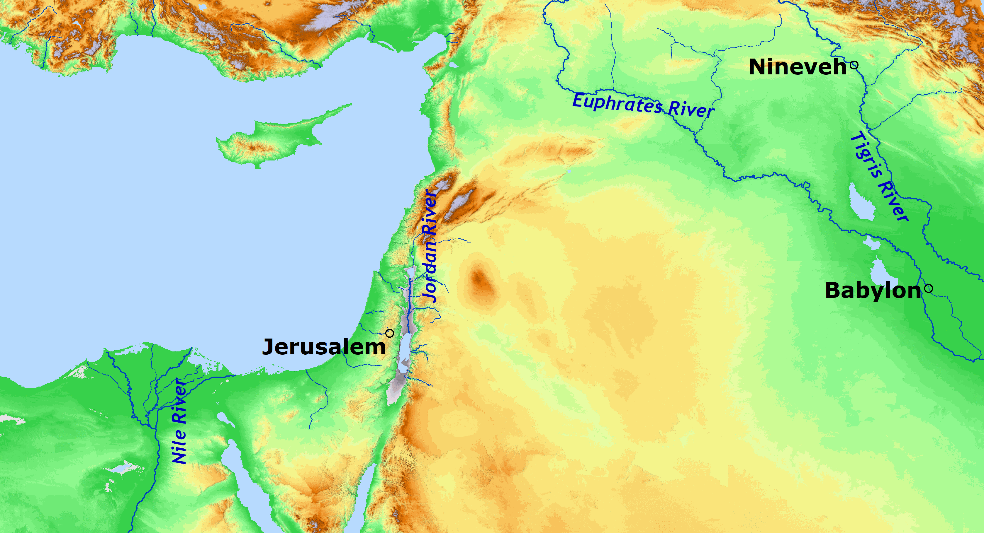
Prophecy Against Assyria

Slide 25
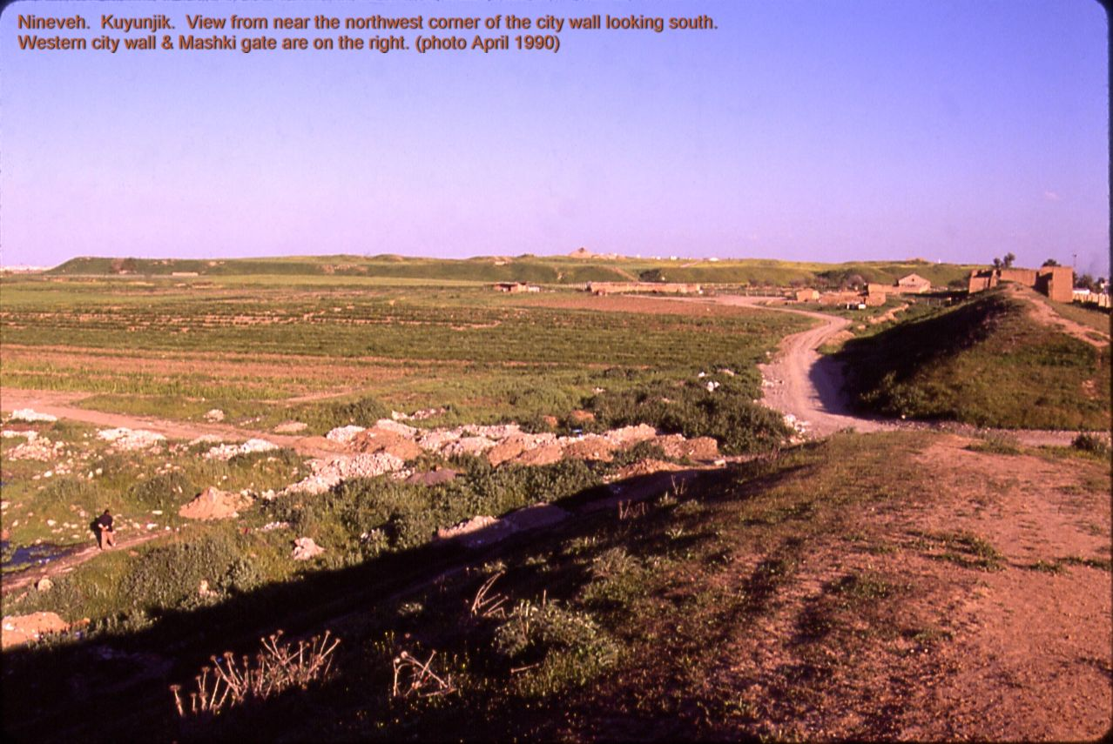
Nineveh Would Be a Desolation
Credit: Fredarch, CC BY-SA 3.0 <http://creativecommons.org/licenses/by-sa/3.0/>, via Wikimedia Commons

Slide 26
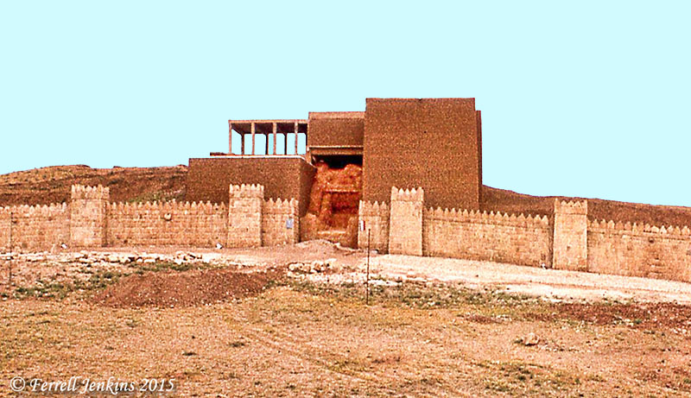
Remains of Nineveh - 2

Slide 27
Warnings and Future Hope
for the Nation
Chapter 3
Sins of the People
Problems in the polluted city (verse 2)
Do not obey God Do not receive correction Do not trust in God Do not draw near to God

Slide 28
Warnings and Future Hope
for the Nation
Chapter 3
Sins of the People
Problems in the polluted city (verse 2) | Evils of the Leaders (verses 3,4)
Do not obey God Do not receive correction Do not trust in God Do not draw near to God | Princes are roaring lions Judges are evening wolves Prophets are insolent, treacherous Priests pollute the sanctuary and do violence to the law

Slide 29
Warnings and Future Hope
for the Nation
Chapter 3
The Remnant Described
Changed character of the remnant (verses 9-13)
Pure speech (verse 9) Unity (verse 9). Worship of God (verse 10) Forgiveness (verse 11) Humility (verses 11,12) Trust in God (verse 12) No lies or deceit (verse 13) No iniquity (verse 13) Security (verse 13)

Slide 30
Warnings and Future Hope
for the Nation
Chapter 3
The Remnant Described
Changed character of the remnant (verses 9-13) | Blessings on the remnant (verses 14-20)
Pure speech (verse 9) Unity (verse 9). Worship of God (verse 10) Forgiveness (verse 11) Humility (verses 11,12) Trust in God (verse 12) No lies or deceit (verse 13) No iniquity (verse 13) Security (verse 13) | Gladness (verse 14) End of punishment (verse 15) Destruction of enemies (verses 15,19) Presence of God (verses 15,17) No fear (verses 15,16) God’s love and joy (verse 17) Worship (verses 18-20) Salvation and praise (verses 19,20) End of captivity (verse 20)

Slide 31
Lessons from Zephaniah
God determined to punish Judah for idolatry and rebellion.
Destiny of ancient cities confirms Bible inspiration. Some were destroyed but others continue to exist as predicted.
Rulers, prophets, and priests, instead of leading people to do right, often lead them into error.
God would bless the future remnant in His way and His time.

Slide 32
© Copyright David E. Pratte, 2021
Permission is granted to display this PowerPoint under the following conditions:
* Display the link to www.BibleStudyLessons.com
* Minor changes in content are permitted, but no teaching should be presented that disagrees with the teaching in the article associated with this PowerPoint on www.BibleStudyLessons.com/powerpoint
* In no case may a fee of any kind be charged for our PowerPoints.
* If you have a website, please add a link to www.BibleStudyLessons.com
Scripture quotations are generally from the New King James Version (NKJV), copyright 1982, 1988 by Thomas Nelson, Inc. Used by permission. All rights reserved.
www.BibleStudyLessons.com

